Slide 1



Mini Project
ANALYZING DATA SCIENCE JOB SALARIES
Implementing SQL
By: Norman Dwi Febrio

Slide 2
CASE STUDY
Suppose you are a data analyst who wants to conduct some analysis of the data science job salaries around the world. You want to know how the data science job salary pattern, and the effect of any factors, such as company characteristics and work remotely, that could affect to the salary.

Slide 3
DATASET INFORMATION
The dataset used in this project is downloaded from Kaggle. You could access the dataset through this link:
Column Name | Description
work_year | The salary was paid
experience_level | The experience level in the job during the year with the following possible values: EN Entry-level / Junior MI Mid-level / Intermediate SE Senior-level / Expert EX Executive-level / Director
employment_type | The type of employement for the role: PT Part-time FT Full-time CT Contract FL Freelance
job_title | The role worked in during the year.
salary | The total gross salary amount paid.

Slide 4
DATASET INFORMATION
Column Name | Description
salary_currency | The currency of the salary paid as an ISO 4217 currency code.
salary_in_usd | The salary in USD (FX rate divided by avg. USD rate for the respective year via fxdata.foorilla.com).
employee_residence | Employee's primary country of residence in during the work year as an ISO 3166 country code.
remote_ratio | The overall amount of work done remotely, possible values are as follows: 0 No remote work (less than 20%) 50 Partially remote 100 Fully remote (more than 80%)
company_location | The country of the employer's main office or contracting branch as an ISO 3166 country code.
company_size | The average number of people that worked for the company during the year: S less than 50 employees (small) M 50 to 250 employees (medium) L more than 250 employees (large)

Slide 5

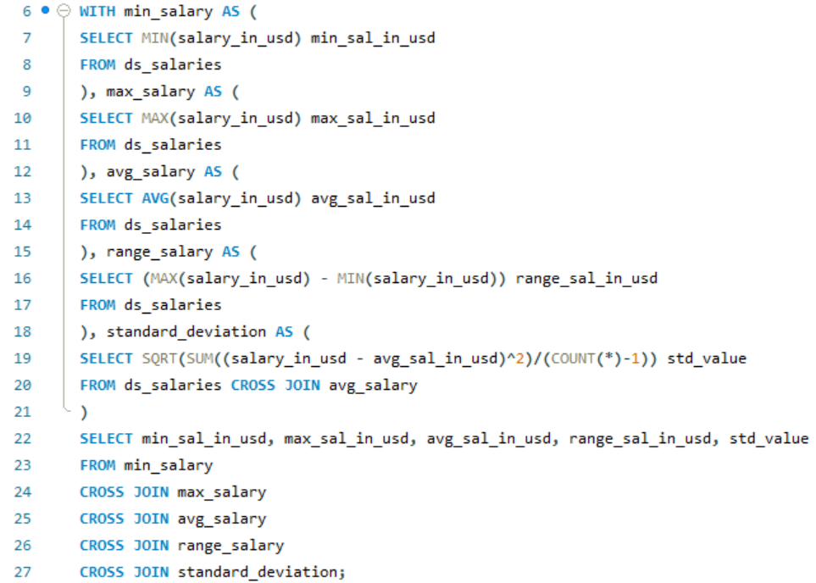

SQL
E
X
R
C
I
S
E
Q1. How is the statistics summary regarding the data science job salary?
Query:

Slide 6
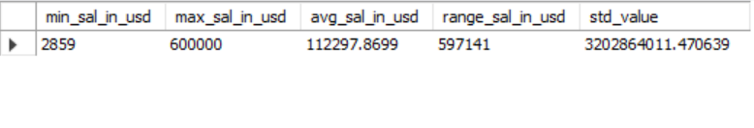
SQL
E
X
R
C
I
S
E
Q1. How is the statistics summary regarding the data science job salary?
Result

Slide 7
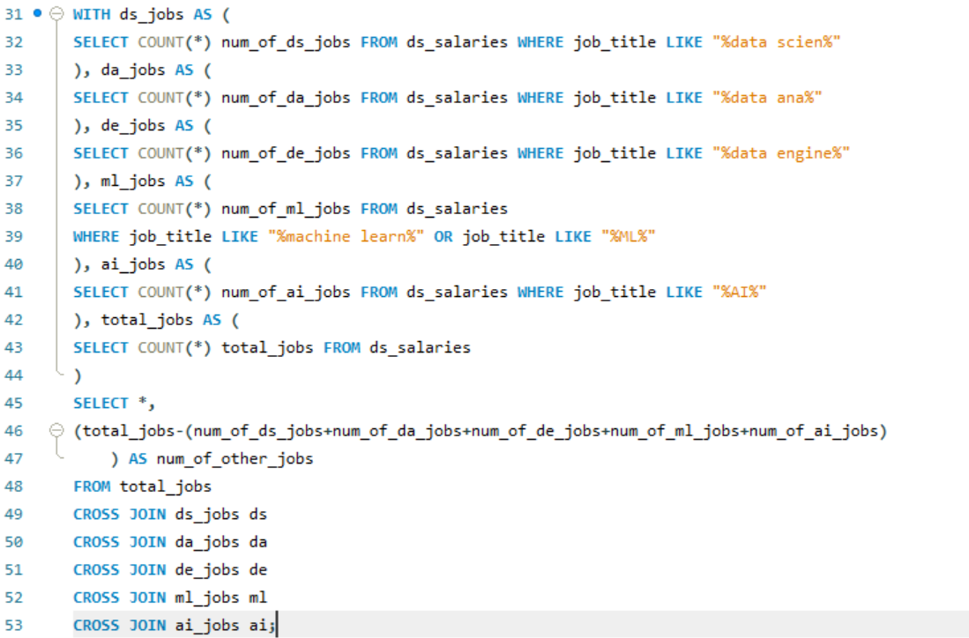
SQL
E
X
R
C
I
S
E
Q2. How many of each are jobs related to data science, data analysis, data engineer, machine learning engineer, AI, and other jobs?
Query:

Slide 8
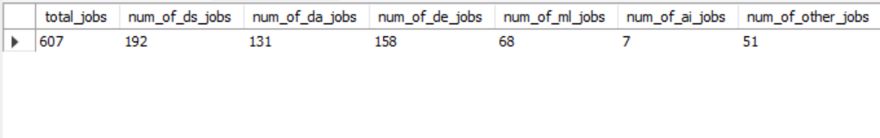
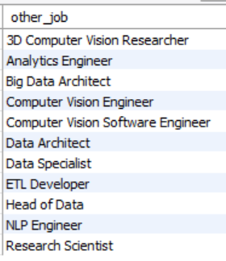
SQL
E
X
R
C
I
S
E
Q2. How many of each are jobs related to data science, data analysis, data engineer, machine learning engineer, AI, and other jobs?
Result
Job titles which labeled as “OTHER”

Slide 9
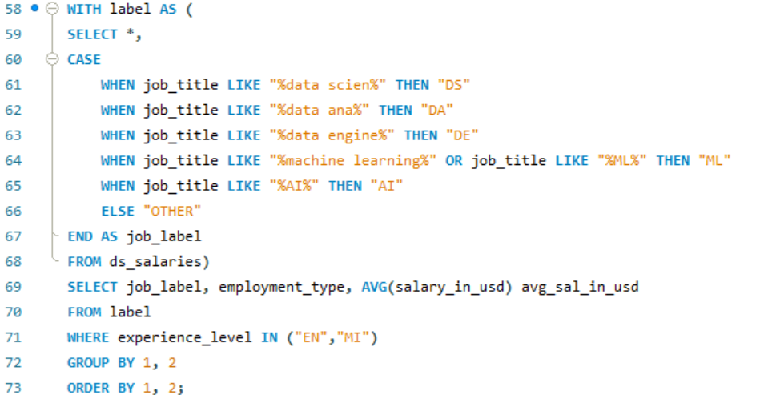
SQL
E
X
R
C
I
S
E
Q3. How much is the average salary for data scientists, data analysts, data engineers, ML engineers, AI engineers, and the other jobs?
Query:

Slide 10
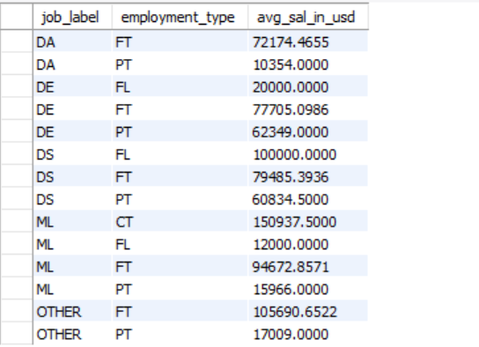
SQL
E
X
R
C
I
S
E
Q3. How much is the average salary for data scientists, data analysts, data engineers, ML engineers, AI engineers, and the other jobs?
Result

Slide 11
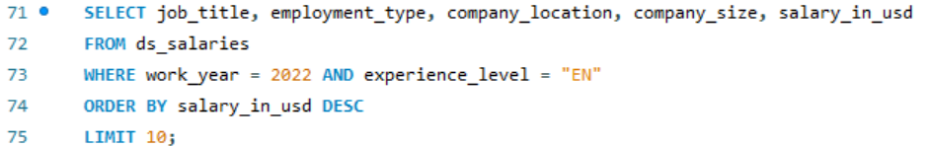
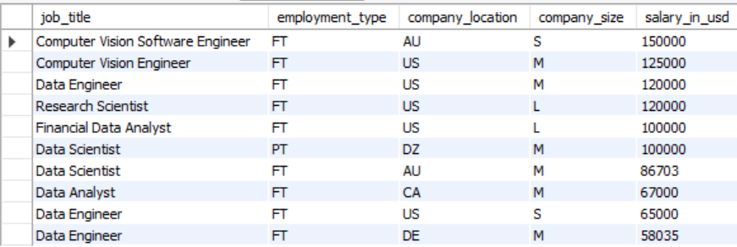
SQL
E
X
R
C
I
S
E
Q4. What are the highest-paying jobs in 2022 with a junior level of experience?
Query:
Result

Slide 12
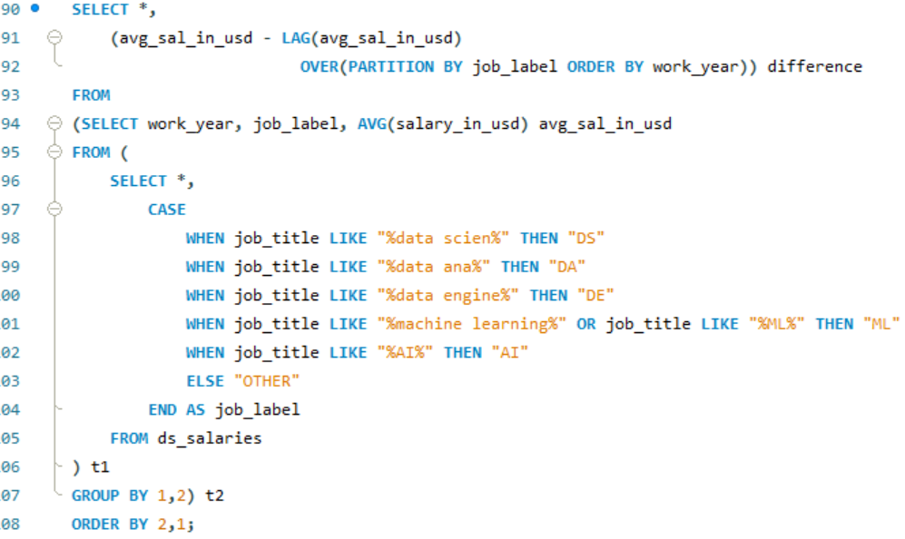
SQL
E
X
R
C
I
S
E
Q5. How is the trend of the average salary and the difference between the previous year?
Query:

Slide 13
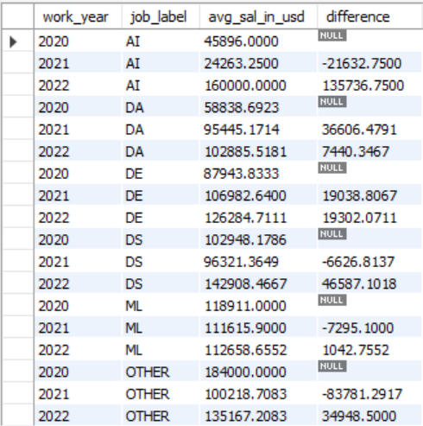
SQL
E
X
R
C
I
S
E
Q5. How is the trend of the average salary and the difference between the previous year?
Result

Slide 14

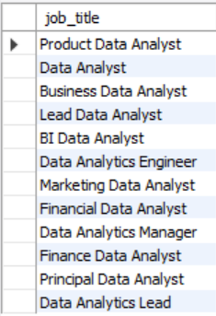
SQL
E
X
R
C
I
S
E
Q6. What kind of job titles are related to data analyst?
Query:
Result

Slide 15
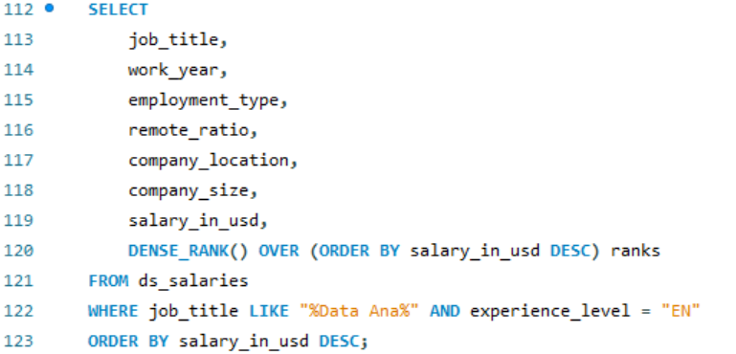
SQL
E
X
R
C
I
S
E
Q7. What are the highest-paying jobs in data analysis for junior level (EN)?
Query:

Slide 16
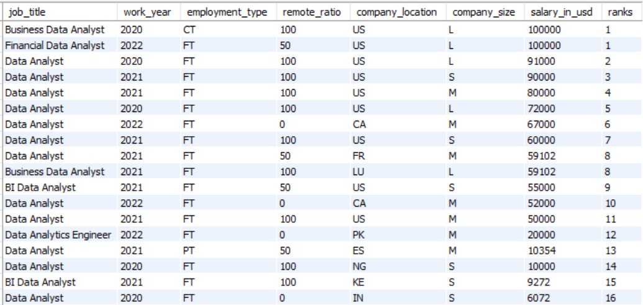
SQL
E
X
R
C
I
S
E
Q7. What are the highest-paying jobs in data analysis for junior level (EN)?
Result

Slide 17
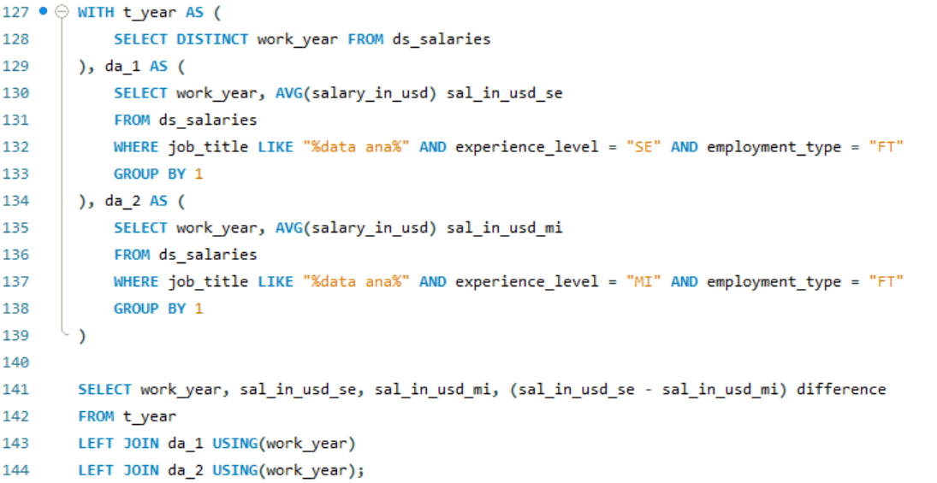
SQL
E
X
R
C
I
S
E
Q8. In which year did the full-time data analyst experience the highest-paying from intermediate level to senior level?
Query:

Slide 18
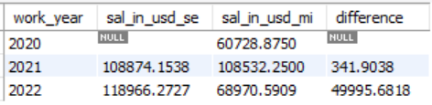
SQL
E
X
R
C
I
S
E
Q8. In which year did the full-time data analyst experience the highest-paying from intermediate level to senior level?
Result

Slide 19
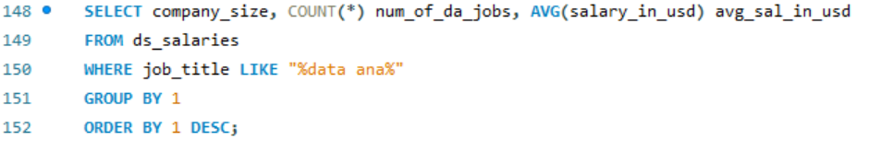
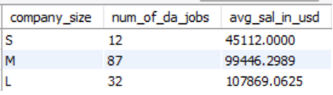
SQL
E
X
R
C
I
S
E
Q9. Does the company size affect the salary of the data analyst jobs?
Query:
Result

Slide 20
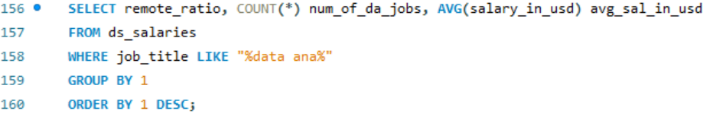
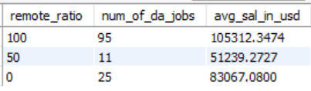
SQL
E
X
R
C
I
S
E
Q10. Does the higher remote ratio have the more salary for data analyst jobs?
Query:
Result

Slide 21
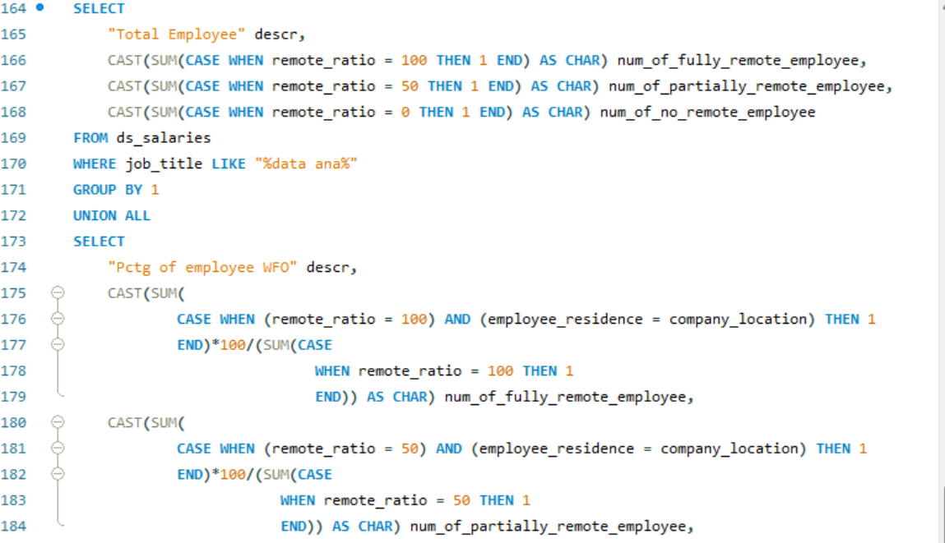
SQL
E
X
R
C
I
S
E
Q11. Is an employee of data analyst who resides in the same country as the location of the company more likely to work from office (WFO)?
Query:

Slide 22
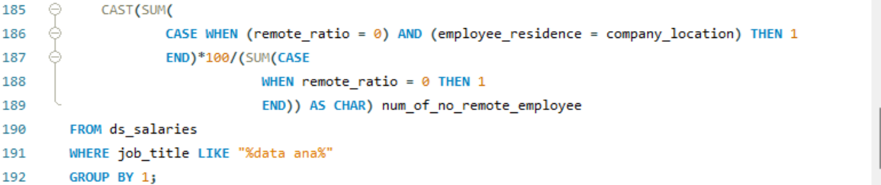
SQL
E
X
R
C
I
S
E
Q11. Is an employee of data analyst who resides in the same country as the location of the company more likely to work from office (WFO)?
Query:
Result

Slide 23
Conclusion
The salary distribution in this dataset is highly skewed (right-skewed). Its maximum value is so high compared to its average. This gap also makes the standard deviation of this dataset could reach US$3.2B marks that the salary dispersion in this dataset is so wide.
This dataset contains more data scientist job titles. Other than that, there are data analysts, data engineers, machine learning engineers, and AI engineers. Also, some jobs are labeled as “OTHER” according to the analysis. These jobs are mostly similar to AI or ML engineers.
The job whose employment type is Part-time (PT) or Freelance (FL), is more likely to have a lower average salary compared to the Full-time (FT) or Contract (CT) job in each job label.
The first two job titles that have the highest-paying jobs in 2022 are Computer vision jobs. The first one is located in Australia with the employment type is Full-time, and the second one is located in the United States with the employment type is Full-time as well.
There are 12 unique job titles regarding the data analyst job.
Data analyst and data engineer jobs have increasing salaries as the years go by. Meanwhile, AI engineer jobs have a significant increase from 2021 to 2022, as well as data scientist jobs. For ML engineer jobs, the decrease and increase in salary is still relatively stable, in the range of US$110k - US$120k.
The highest-paying jobs in the data analyst job are Business Data Analyst (2020) and Financial Data Analyst (2022). The company of these two jobs is located in the United States and has the same company size (L). These jobs could be done remotely with a remote ratio of over than 20%.
The Full-time data analyst job experienced the highest-paying from intermediate to senior level in 2022, which has almost reached US$50k in increment.

Slide 24
Conclusion
9. The size of the company affects to the data analyst job salaries. The larger its company, the higher its data analyst salary.
10. The higher remote ratio doesn’t always have the higher salary for data analyst jobs. Yet, the data analyst jobs with remote ratio more than 80% (labeled as 100) have the higher salary compared to the data analyst jobs with remote ratio less than 20% (labeled as 0).
11. Most of the employee more likely to live in the same country even though the remote ratio is more than 80%.

Slide 25




THANK YOU
Let’s Connect!!!
normanfebrio
Norman Dwi Febrio
Norman Dwi Febrio
NormanFebrio

